Slide 1
AFS-220 Travel Website Project Presentation
Team members:
Gary Fishback
Brevan Daniels
Jessica Gray

Slide 2
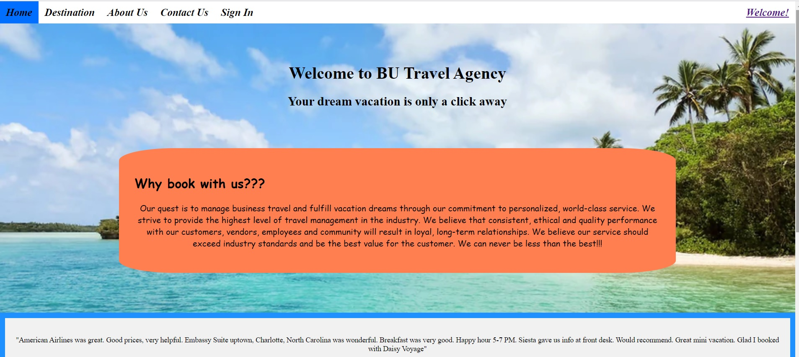
Home Page
Nav bar
Greeted by Welcome page:
Mission statement
Customer Reviews
Nav bar
Mission Statement
Customer Reviews

Slide 3
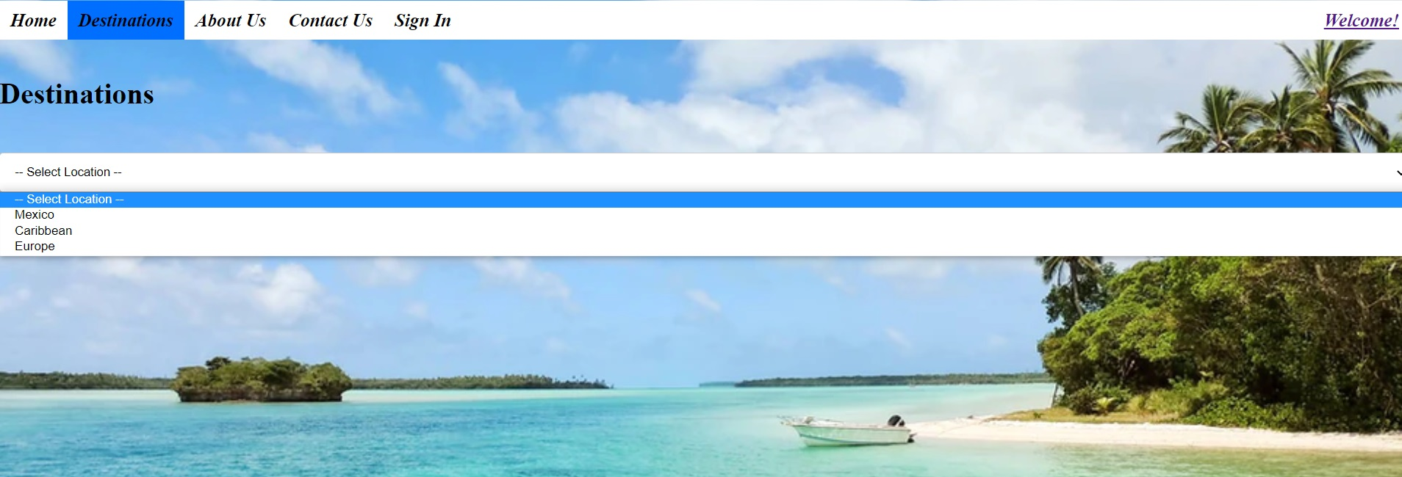
destinations Page
Search destination by location
Mexico
Caribbean
Europe
Add destinations to wish-list
Destinations on wish-list are added to user profile page
Site visitors not logged in will be redirected to the Sign-In page

Slide 4


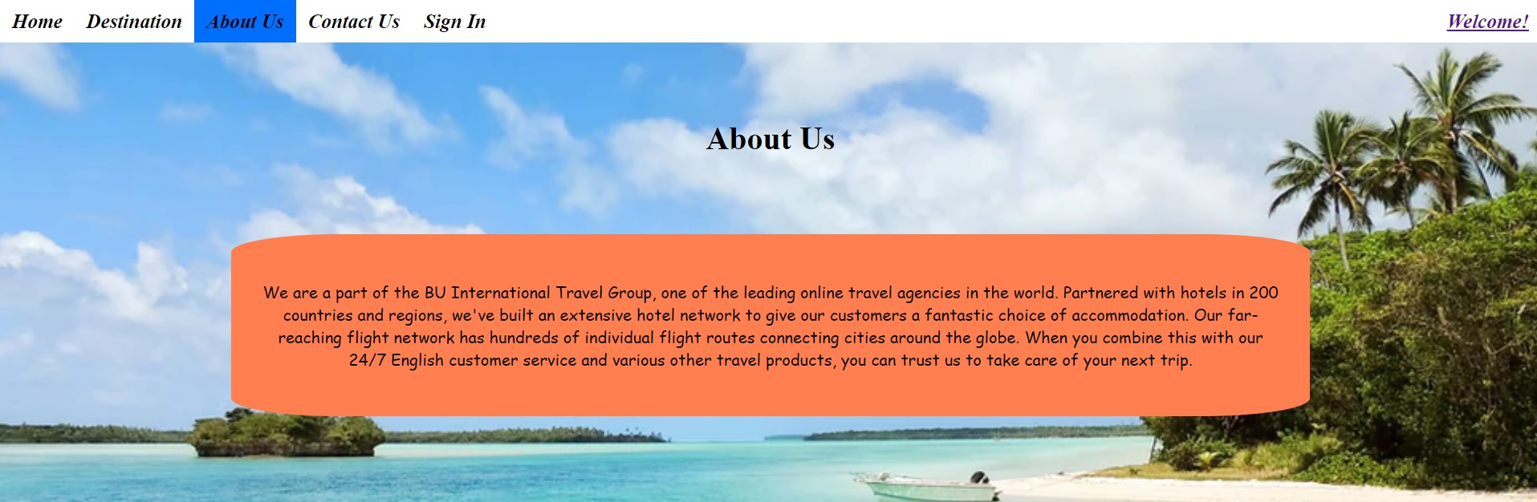
ABOUT US Page
Static page with company’s history and advantages
History\Advantages

Slide 5
CONTACT US Page
Form for potential customer info, and questions
Messages save to Contacts table for Admin to view in Admin page

Slide 6
Sign-in and Registration pages
Sign-in page for user login with username and password
Link to registration page for visitors with no account set up.
Redirects users to Home page after successful login
Registration Page for visitors to create an account.
Requires username, email and password
Must confirm password
Must be unique and not common(password123, etc..)

Slide 7
Profile Page
Lists destinations added to the wish-list
Visitors not logged in will see link to sign in.
If no destinations were added page is blank

